Slide 1
Backhoe Inspection: Feedback (Screenshots)
By: Humza Sheikh

Slide 2
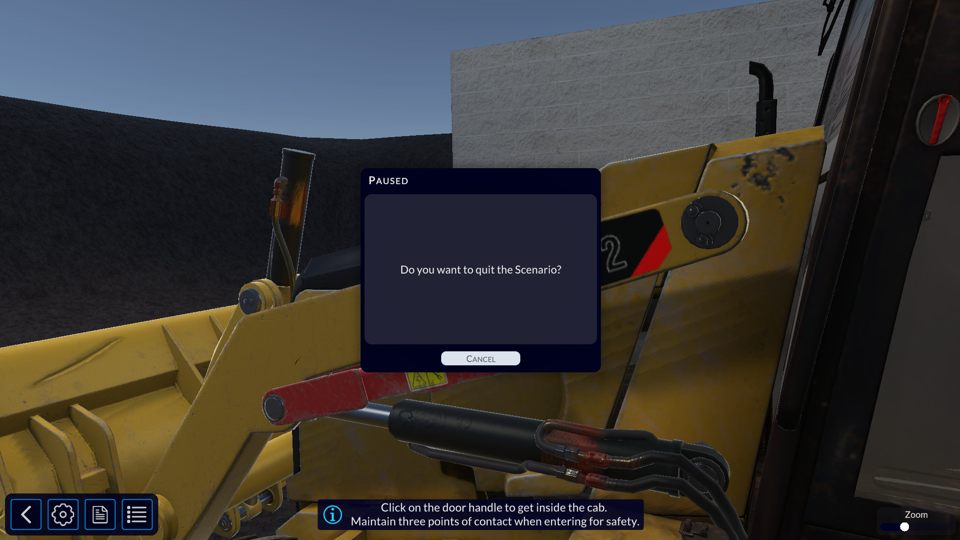
Screenshots Of The Problems
There is no dedicated exit button

Slide 3
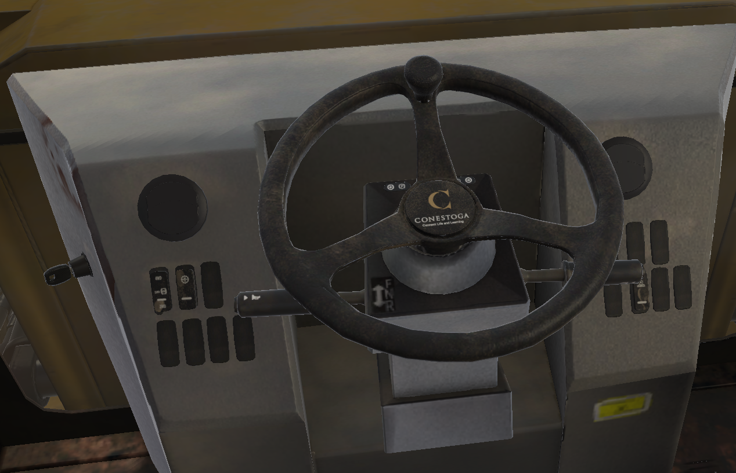
Screenshots Of The Problems
The texture on labels on the button in the interior need to be cleaned up

Slide 4
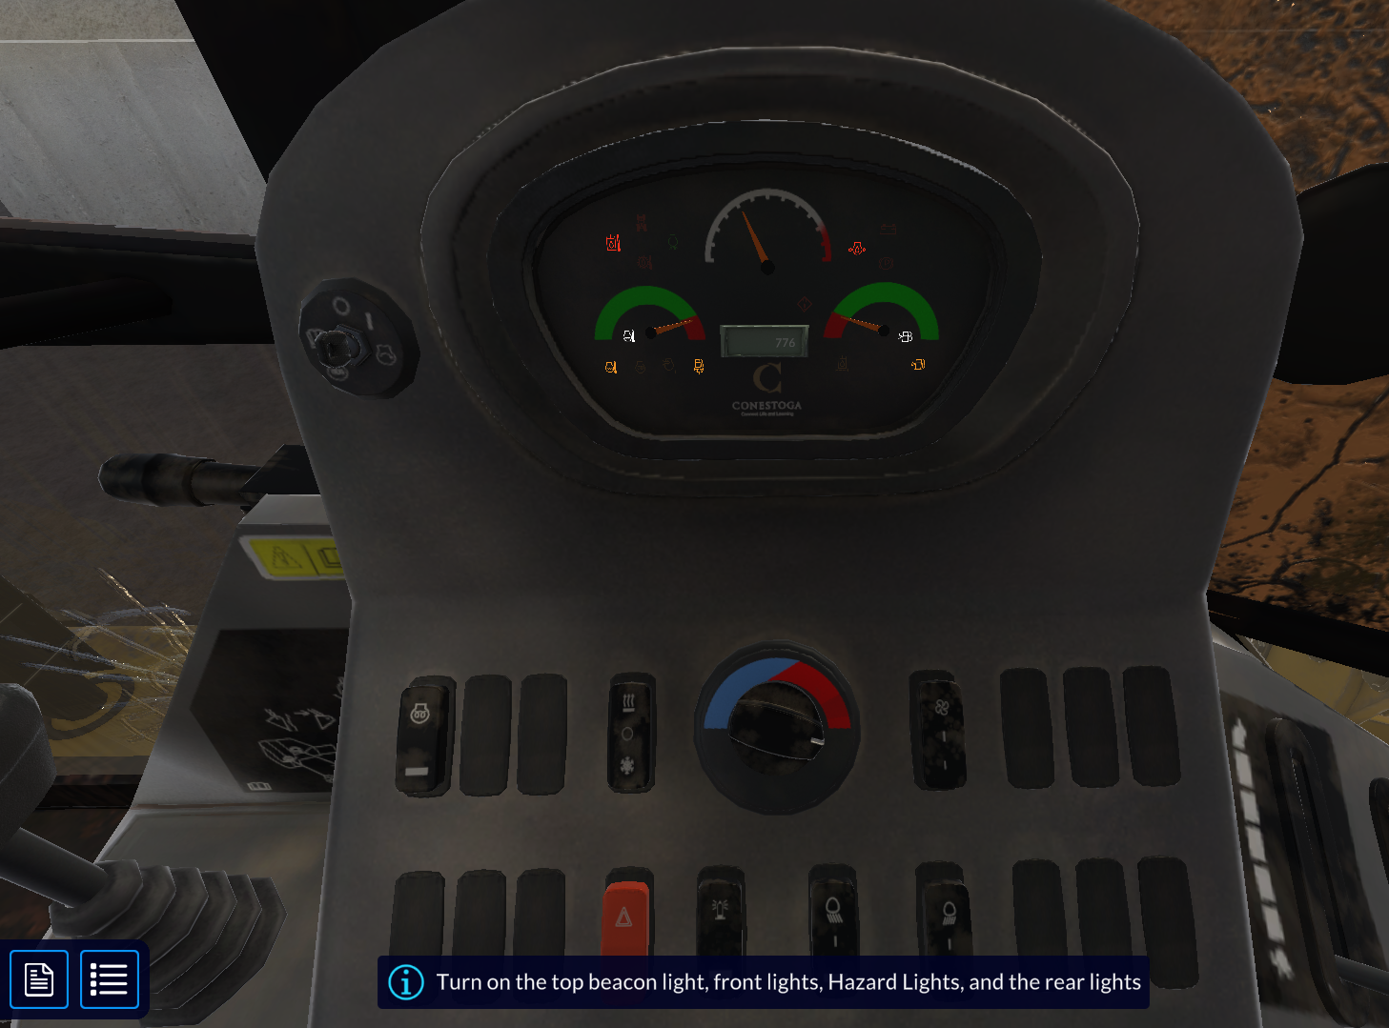
Screenshots of Suggestions
Having checklist of the current task.
Task Lists (0/4):
Top Beacon light
Front lights
Hazard lights
Rear lights

Slide 5
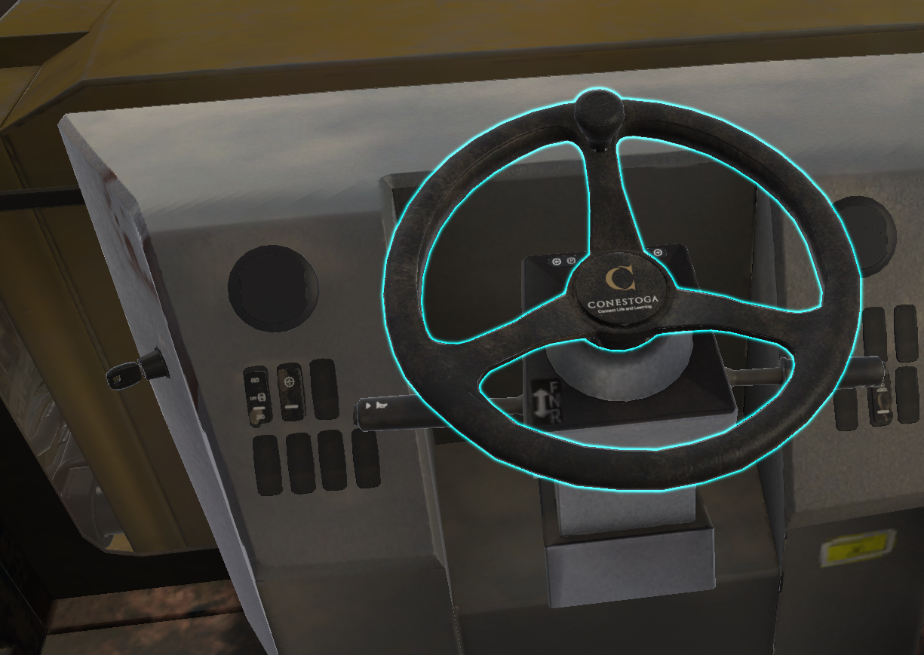
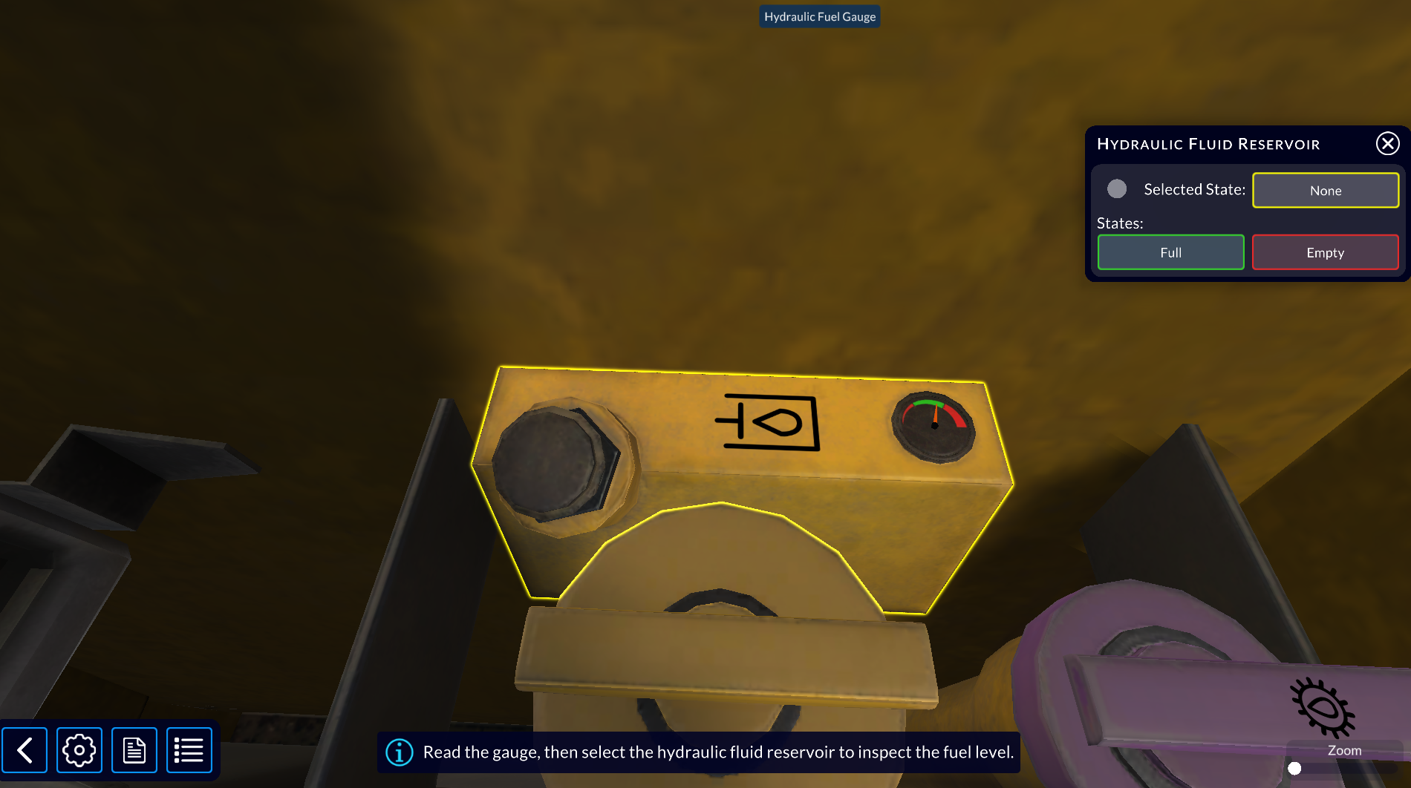
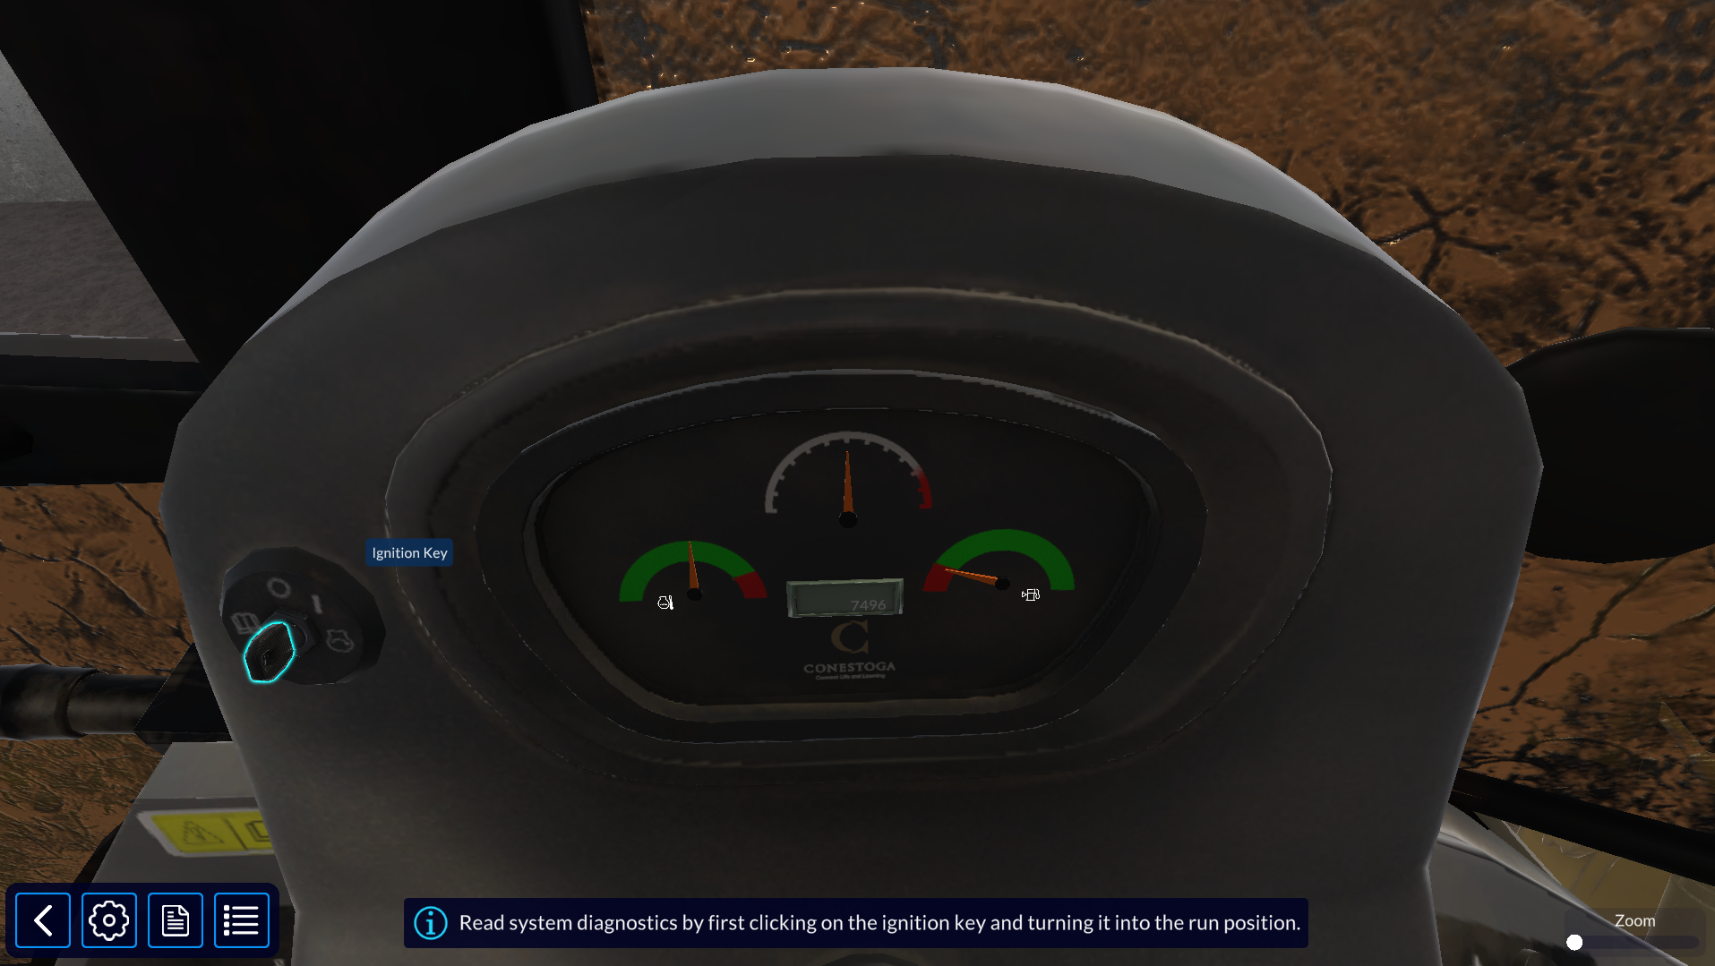
Screenshots of Suggestions
Make sure the highlight color is consistence, when highlighting individual part its yellow or blue and when it’s small individual part, it highlights it in yellow or blue. So, make sure the highlight color is one color for consistence.

